Slide 1
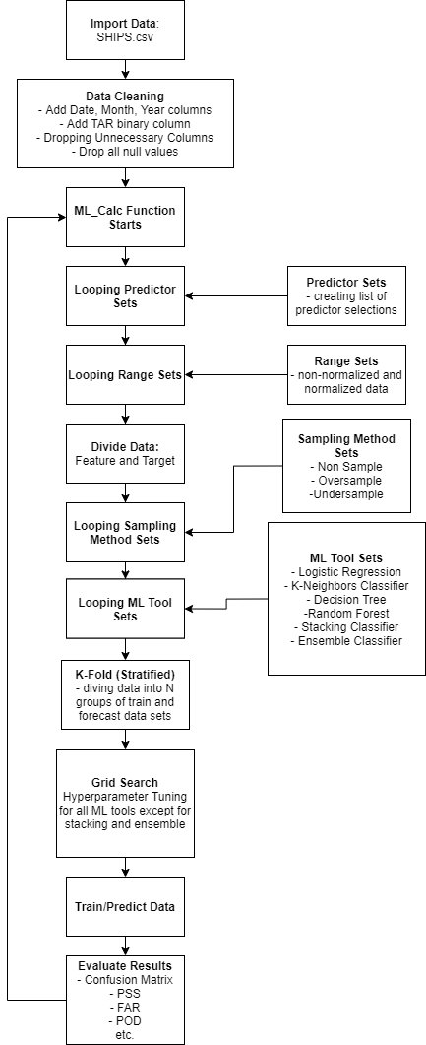
Updates to the Prediction Model
Pre-processing Data to Increase Data Size
Ensemble and Stacking Classifier Added
Added Hyperparameter Tuning (Grid Search)
Implemented K-Fold Validation

Slide 2
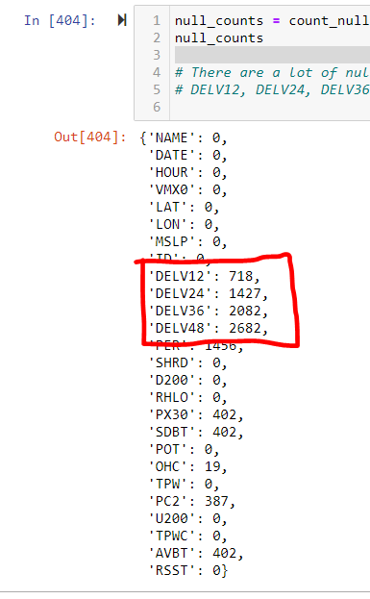
Pre-processing Data to Increase Data Size
Before : Drop all rows with null values without pre-processing
After: Additional pre-processing to drop less rows
Result: Saved 1971 rows from being unnecessary deleted

Slide 3
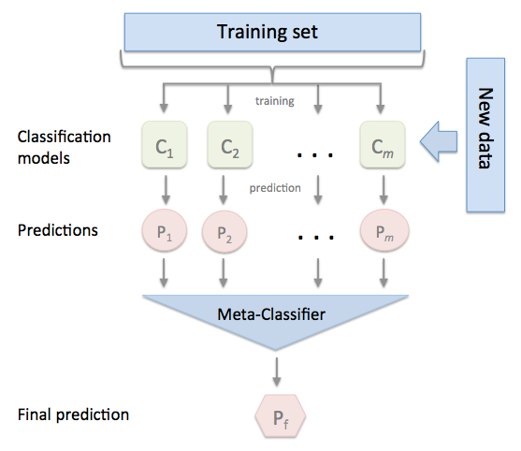
Ensemble and Stacking Classifier Added
Definitions
Ensemble Classifier
This combines different machine learning classifier output into one (average)
Allows different weights for each ML classifiers
Stacking Classifier
Stacking Classifier is more advanced ML algorithm that combines multiple machine learning algorithms into one
Before: No ensemble methods
After: Added Ensemble and Stacking Classifier
Result:

Slide 4
Added Hyperparameter Tuning (Grid Search)
Definitions
GridsearchCV
GridsearchCV processes multiple hyperparameters of ML algorithms and chooses the parameters with the best results
Before: Manual Hyperparameter Tuning
After: Automatic Hyperparameter Tuning
Result: More accurate prediction models

Slide 5
Implemented K-Fold Validation
K-Fold Sampling
The k-fold cross-validation procedure involves splitting the training dataset into k folds. The first k-1 folds are used to train a model, and the holdout kth fold is used as the test set. This process is repeated and each of the folds is given an opportunity to be used as the holdout test set. A total of k models are fit and evaluated, and the performance of the model is calculated as the mean of these runs
Stratified K-Fold Sampling
K-Fold sampling while maintaining the same class distribution
Before: Using ‘YEAR’ column to divide dataset into two (train and forecast)
After: Stratified K-Fold to divide the datasets
Result: More reliable evaluation of ML models

Slide 6
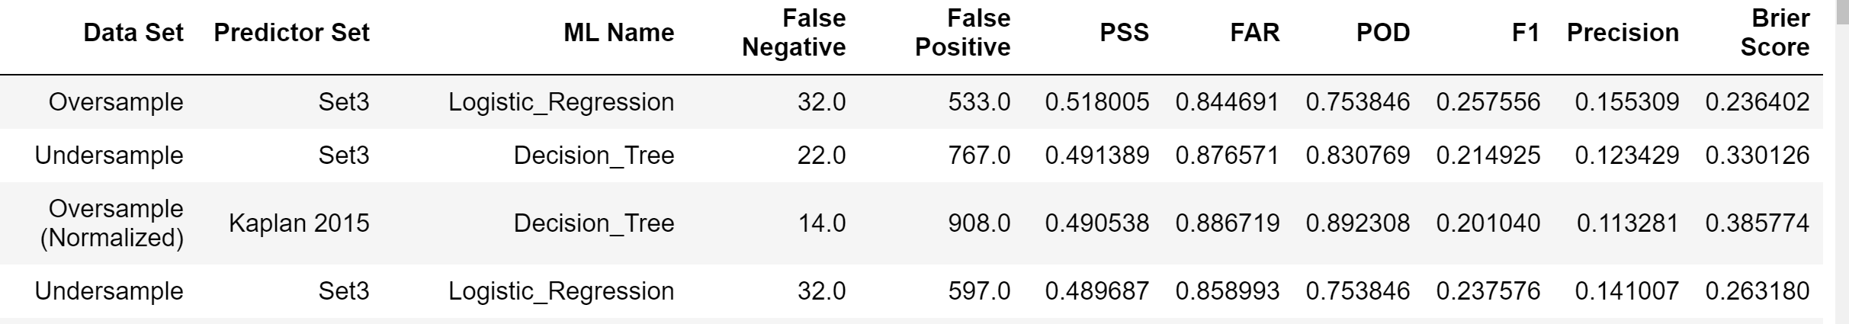
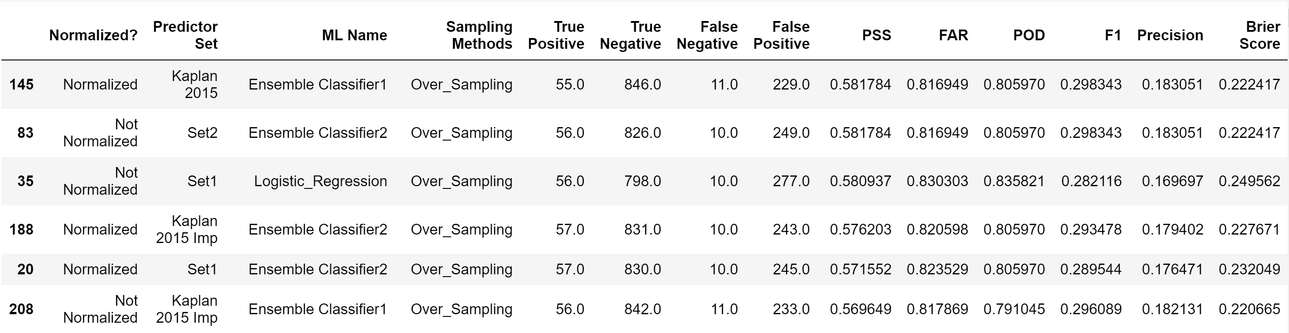
Results
Before :
Updated :
With the update, the number of false negative has dropped significantly as well as PSS score.

